Slide 1

Chapter Two (a)
SWE 421 - Game Development
Software Engineering Department
College of Engineering and Architecture
Al Yamamah University
Basics of HTML
Instructor: Layla Albabtain Fall 2019

Slide 2
What is HTML
HTML is an abbreviation of Hypertext Markup Language
Hypertext:
Allows for non-linear linking to other documents
Markup Language:
Content to be displayed is “marked up” or tagged to tell the browser how to display it.

Slide 3
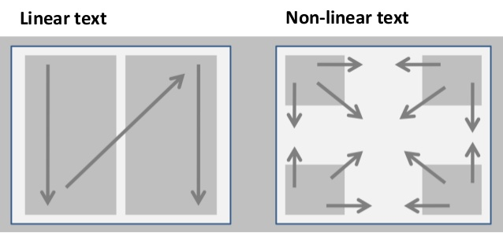

Slide 4
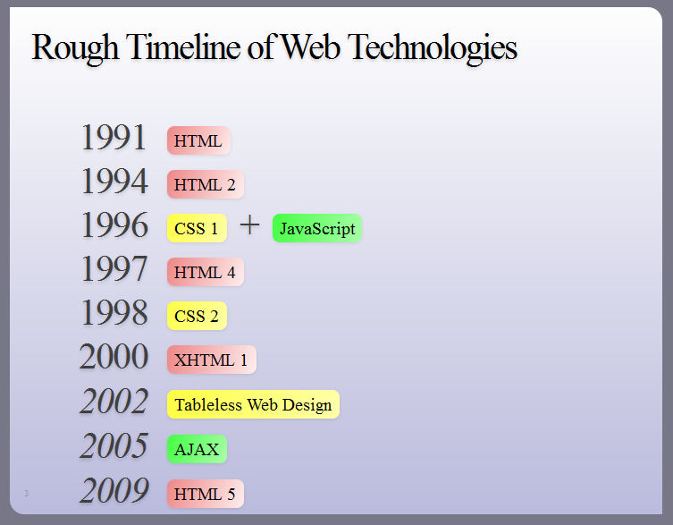
History of HTML
HTML was created in 1991 by Tim Berners-Lee at CERN in Switzerland.
It was designed to allow scientists to display and share their research.

Slide 5
HTML Basics
HTML is primarily composed of two types of markup:
Elements or tags
<opening-tag> content </closing-tag> ← Syntax
E.g: <html></html> and <p></p> ← example
Attributes that modify an element
<tag attribute=”type of attribute: value of attrib ute;”> </closing-tag>
E.g: <p style=”color: red; font-size: larg;” class=“hello”>content</p>

Slide 6
Elements
Elements / tags are the fundamental building blocks of HTML.
They are the tags that tell the browser what the enclosed text is.
<title>My first HTML page</title>
The title element tells the browser that this is the title of the page.
Elements must be terminated.
<p> I love Web ← </p>
(the <p> element is not terminated using </p>).

Slide 7
Basic HTML Syntax - 01
General format of an element: <startTag>Target content</endTag>
E.g:
<h1>This is a header</h1>
<p> This is a paragraph </p>
HTML is NOT case sensitive. However, using lower case letters is the convention of HTML.
This means both: <H1></h1> will work. But, <h1></h1> is the preference.
For more about HTML convention chick this link.

Slide 8
Basic HTML Syntax - 02
Not all tags have content If a tag has no content, its form is <name />: <br />
<name/> →<br/>
<name> → <br>
<hr style=“color:red;”>
The container and its content together are called an element
If a tag has attributes, they appear between its name and the right bracket of the opening tag
Comments in programs increase the readability of those programs
- <!-- … -->
Browsers ignore comments, unrecognized tags, line breaks, multiple spaces, and tabs
Tags are suggestions to the browser, even if they are recognized by the browser
Notes:
We stopped here!

Slide 9
Example
Copy the following in an notepad and save the file as TagsWebPage.html
<html>
<!-- This is a comment, it will not appear in the web page -->
<p> This is an Element/tag that has content, the content are what you reading here </p>
<p> &lt;br /&gt; tag doesn't have a content. it just add a new line. </p>
</html>
&lt; br / &gt; → &lt;p&gt; &lt;/p&gy;
< br /> -> <p> </p>

Slide 10
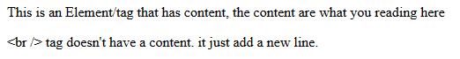
This is how the web site will appear if you open the MyFirstWebPage in a browser.

Slide 11
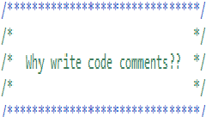
Hint
Event though comments will not appear in the page it self, it is still important.
It helps in case:
You are checking an old code you have written to figure out what is that code.
If you hand the work to someone else, they can understand your code.

Slide 12
XHTML and HTML - 01
In XHTML, element and attribute names must be in all lowercase letters.
In HTML, they can be any combination of uppercase and lowercase.
XHTML is stricter than HTML, in HTML this code will work:
<html>
<head>
<title> Bad HTML </title>
<body>
<H1> Bad HTML
<p> This is an example of a bad html web-page.

Slide 13
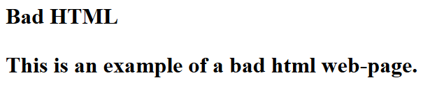
Even though all of <html>, <head>, <body>, <h1> and <p> are not closed the page will work with some issues (the text in the <h1> and <p> are all considered as header text) like the image below.
Hint: Try the same code without closing the <title> tag and see what happens.

Slide 14
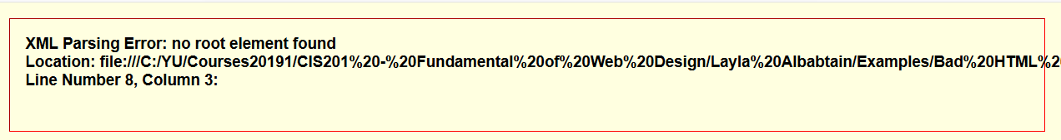
XHTML and HTML - 02
The same code will not work in XHTML.
To try it, save the same bad code as: BadHTML.xhtml.
Opening the page will get an error as you see below:

Slide 15
XHTML and HTML - 03
To fix the bad HTML close all the tags and use small letters for tag names. As follows:
<html>
<head>
<title> Bad HTML </title>
</head>
<body>
<h1> Bad HTML </h1>
<p> This is an example of a bad html web-page. </p>
</body>
</html>

Slide 16
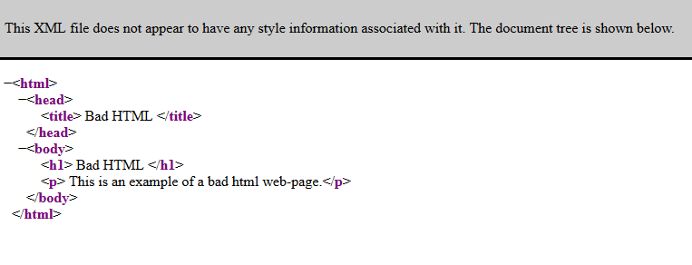
After closing all the tag, the xhtml will appear as follows:
It is being treated by the browser as XML file and not XHTML.

Slide 17
XHTML and HTML - 04
To tell the browser this is an XHTML and not XML we need to add document type as follows:
<!DOCTYPE html PUBLIC "-//W3C//DTD XHTML 1.0 Strict//EN" "http://www.w3.org/TR/xhtml1/DTD/xhtml1-strict.dtd">
<html xmlns="http://www.w3.org/1999/xhtml">
<head>
<title> Bad HTML </title>
<meta charset=“UTF-8”/>
</head>
<body>
<h1> Bad HTML </h1>
<p> This is an example of a bad html web-page. </p>
</body>
</html>

Slide 18
XHTML and HTML - 05
To conclude:
To save a webpage as XHTML not HTML the file name should be: name.XHTML.
In HTML uppercase letters or lowercase letters in tag names and attribute names and values is ok but in XHTML they all must be in lower case letters.
In HTML not closing the tag will still work with some issues, but in XHTML all tags must be closed.
XHTML we must declare the document type.
Examples of Bad HTML has been uploaded to the lms, check them.

Slide 19
Programmers and HTML
Programmers find XHTML a bit frustrating. In a program, the statements specify exactly what the computer must do.
If a reserved word is misspelled in a program, the error is usually detected by the language implementation system and the program is not executed. E.g
<body> </obdy> (a synatx error) will not be detected.
However, a misspelled tag name usually results in the tag being ignored by the browser, with no indication to the user that anything has been left out.
<body> </obdy> The browser will ignore the <body> element/tag.

Slide 20
Standard XHTML Document Structure
Every XHTML document must begin with: DOCTYPE.
The Elements <html>, <head>, <title>, and <body> are required in every document (in XHTML, not HTML).
The whole document must have <html> as its root (all other elements between <html> </html>
html must have the lang attribute:
<html lang = ″en″> (this one is for English)
A document consists of a head and a body
The <title> tag is used to give the document a title, which is normally displayed in the browser’s window title bar (at the top of the display)
The meta tag is used to provide the character set used
<meta charset = ″utf-8″ />.

Slide 21
<!DOCTYPE html PUBLIC "-//W3C//DTD XHTML 1.0 Strict//EN" "http://www.w3.org/TR/xhtml1/DTD/xhtml1-strict.dtd">
<html xmlns="http://www.w3.org/1999/xhtml" lang="en">
<!-- The DOCTYPE is declared at the top. </html-->
<!-- The <html> has the language attribute set </html> -->
<!-- All elements are between the <html> and </html> -->
<!-- The page has a head, a title and a body element. -->
<!-- The character set used for the page has been set to Unicode: utf-8 in the <meta /> in the <head> -->
<head>
<meta content="charset=utf-8;" />
<meta charset=“utf-8” />
<title> Good XHTML </title>
</head>
<body>
<h1> Good XHTML </h1>
<p> This is an example of a good XHTML web-page.</p>
</body>
</html>

Slide 22
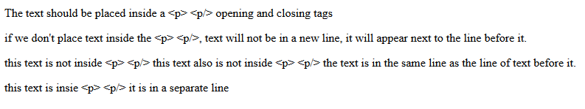
Basic HTML - Text
Text is normally placed in paragraph elements
The <p> tag breaks the current line and inserts a blank line
The new line gets the beginning of the content of the paragraph.
The closing tag is required in XHTML, not in HTML.
Check the example web-page below:

Slide 23
<!DOCTYPE html>
<!-- good HTML.html A trivial document -->
<html lang="en">
<head>
<title>A good HTML</title>
<meta charset="UTF-8" />
</head>
<body>
<p>This is a good HTML</p>
</body>
</html>

Slide 24
Document Type Declaration (DTD)
There are different types of HTML and XHTML.
Declaring the type tells the browser which HTML/XHTML we are using.
HTML may work with no DTD but XHTML (as seen in above examples) will not.
<!DOCTYPE ….> is the syntax to declare Document type.
<!DOCTYPE html> is for declaring HTML5.
For more about HTML and XHTML DTD check this link.
In this course we will work with HTML5.

Slide 25
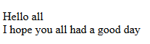
Basic HTML - Line break
To add a new line between elements we can use <br />
<br /> is an empty tag, it as no content.
The effect of the <br /> tag is the same as that of <p>, except for the blank line
The tag can be written as <br> or <br />.
<!DOCTYPE html>
<html lang="en">
<head>
<title> Line Break Example </title>
<meta charset="UTF-8" />
</head>
<body>
<p> Hello all <br />
I hope you all had a good day
</p>
</body>
</html>

Slide 26
Basic HTML - Preserving white Space
The text content of a <pre> element is displayed as it is entered.
<pre> is used to prevent the browser from eliminating multiple spaces and from ignoring embedded line breaks.
Notes:
The scope of the project outlines the objectives of the project and the goals that need to be met to achieve a satisfactory result.

Slide 27
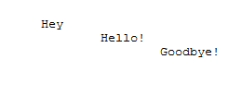
Example - Preserving white Space
<!DOCTYPE html>
<html lang="en">
<head>
<title> Line Break Example </title>
<meta charset="UTF-8" />
</head>
<body>
<P>
<pre>
Hey
Hello!
Goodbye!
</pre>
</p>
</body>
</html>

Slide 28
Basic HTML - Headings
To enter a section Header we can use <h1> </h1> tags.
There are 6 headers with six sizes. 1 - 6, specified with <h1> to <h6>.
Sizes compared to default text size:
1, 2, and 3 use font sizes that are larger than the. default font size.
4 uses the default size.
5 and 6 use smaller font sizes.
All headings are in bold.
For more about Headings.

Slide 29
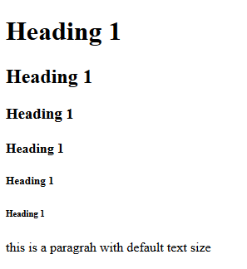
Example - Headings
<!DOCTYPE html>
<html lang="en">
<head>
<title> Heading Examples </title>
<meta charset="UTF-8" />
</head>
<body>
<h1> Heading 1 </h1>
<h2> Heading 2 </h2>
<h3> Heading 3 </h3>
<h4> Heading 4 </h4>
<h5> Heading 5 </h5>
<h6> Heading 6 </h6>
<p> this is a paragraph with default text size </p>
</body>
</html>

Slide 30
Basic HTML - Blockquotes
Content of <blockquote> look different from the surrounding text
Browsers often indent, and sometimes italicize.
It has cite attribute where we can provide the link from the place the quote was gotten from. It will not appear on the website.
<cite> </cite> tag can be used to cite the quote.
For more about Blockquote and Cite.

Slide 31
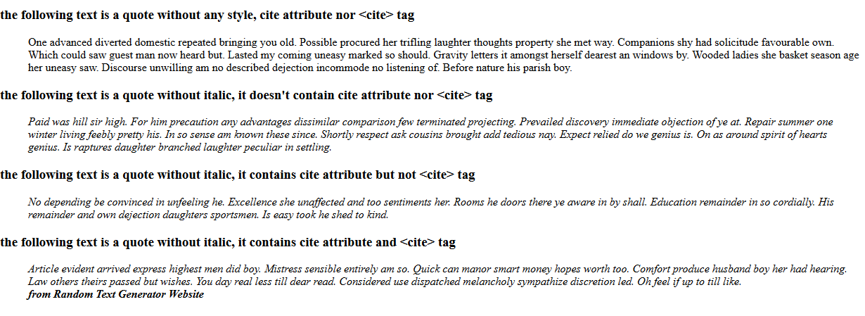
Example - Blockquotes
Check the lms for Blockquote example. The result will be:

Slide 32
Basic HTML - Font Style
For a number of word style, we can put them between:
<i> for italics </i>
<b> for bold </b>
content-based style tags.
indicates the particular kind of text that appears in their content.
Emphasis - <em> specifies that its textual content is special (often set in italics).
Strong - <strong> (often set in boldface).
Monospace - <code> (often set in Courier).
<code> cost = quantity * price </code>.

Slide 33
Example - Font Style
<!DOCTYPE html>
<html lang="en">
<head>
<title> Font Style Examples </title>
<meta charset="UTF-8" />
</head>
<body>
<p> This word is <i>italic</i> and this word is <b>bold</b>. </p>
<p> This word is <em>emphasised </em> and this word is <strong>strong </strong>. </p>
<p> This word is a <code>monospace</code>. </p>
</body>
</html>

Slide 34
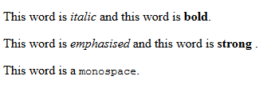
Example - Font Style

Slide 35
Basic HTML - Font Style and Blockquote
Character-modifying tags are not affected by <blockquote>, except when there is a conflict.
For example, if the text content of <blockquote> is set in italics and a part of that text is made the content of an <em> tag, the <em> tag would have no effect.
For more on Font Style and weight.
Font Style are CSS not HTML.

Slide 36
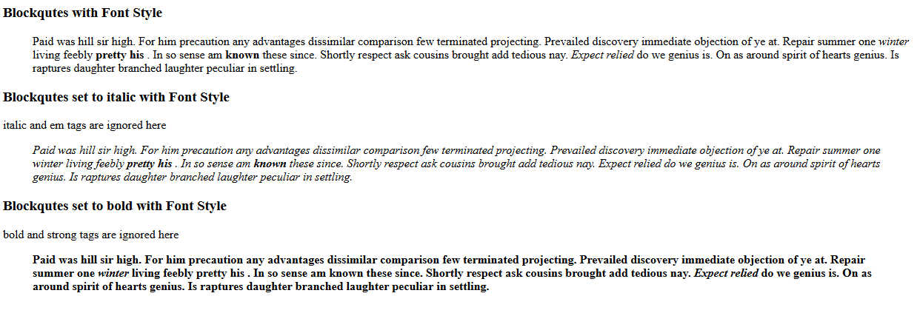
Example - Font Style and Blockquote:

Slide 37
Basic HTML: Superscripts and subscripts
Subscripts with <sub>
Superscripts with <sup>
Example:
Check this link.

Slide 38
Inline versus Block Elements
XHTML tags are either block or inline.
The content of an inline tag appears on the current line.
A block tag breaks the current line so that its content appears on a new line.
The heading <h1>, Paragraph <p> and blockquote <blockquote> tags are block tags,
<em> and <strong> are inline tags.
In XHTML:
Block tags cannot appear in the content of inline tags.
A block tag can never be nested directly in an inline tag.
Also, inline tags and text cannot be directly nested in body or form elements.
Only block tags can be so nested.

Slide 39
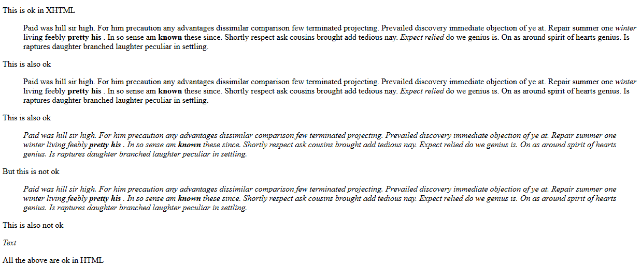
Inline versus Block Elements - Example
Check lms for examples.

Slide 40
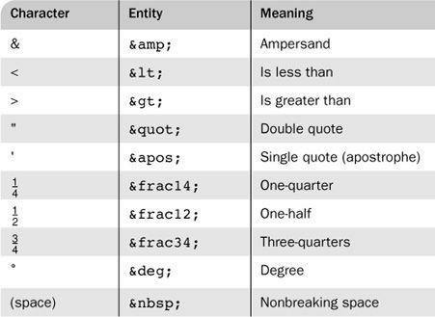
HTML Symbol Entities
Special characters are defined as entities which are codes for the characters.
An example, to make <p> appears in an HTML page we write it as follows:
< = &lt
> = &gt
<p> = &lt;p&gt;
</p> = &lt;/p&gt;

Slide 41
Basic HTML - Horizontal Line
Separates parts of a document from each other, making the document easier to read,
placing horizontal lines between them.
The <hr style=“color:red width: 5px;” /> tag causes a line break (ending the current line) and places a line across the screen.
The browser chooses the thickness, length, and horizontal placement of the line.
Typically, browsers display lines that are three pixels thick.
Note again the slash in the <hr /> tag, indicating that this tag has no content and no closing tag.

Slide 42
Example - Horizontal Line
<!DOCTYPE html>
<!-- greet.html A trivial document -->
<html lang="en">
<head>
<title> Horizontal Line </title>
<meta charset="UTF-8" />
</head>
<body>
<p>Before Line </p>
<hr />
<p> After Ling <p>
</body>
</html>

Slide 43

Images - Formats
GIF (Graphic Interchange Format)
8-bit color (256 different colors)
Can have transparent backgrounds.
Can be animated.
JPEG (Joint Photographic Experts Group)
24-bit color (16 million different colors)
can’t be made to appear transparent.
Both use compression, but JPEG compression is better
Portable Network Graphics (PNG)
transparency, as provided by GIF,
the same large number of colors as JPEG
require more space than JPEG image.

Slide 44
Basic HTML: Images
Images are inserted into a document with the <img /> tag
includes two attributes:
src,: specifies the file containing the image;
Alt: specifies text to be displayed when it is not possible to display the image
Example:
<img src = "comets.jpg" alt = "Picture of comets" />
The <img> tag has 30 different attributes, including width and height (in pixels).
For more about images.

Slide 45
Example: Images
<html>
<head> <title> Images </title> </head>
<body>
<h1> Images </h1>
<p> we can have images in websites </p>
<p> For adding images we will use the &lt;img&gt; tag and the src attribute. </p>
<p> if image in the same folder of the web page, we set the value of source to the image file name &lt;img src="6.jpg"/&gt; </p>
<img src="6.jpg" width ="500" height="250"/>
<p> if an image is in a folder we use the foler name along side the image name sperated by / as follows: &lt;img src="imgs/1.jpg"&gt; </p>
<img src="imgs/1.jpg" />
<p> Images can be added from other websites, we set the url of the image to the scr attribute</p>
<img src="https://i.vimeocdn.com/portrait/25122243_300x300" />
<p> images has many attributes, width, height and alt are the mainly used attributes </p>
<p> for more about images please click on <a href="https://www.w3schools.com/html/html_images.asp" target="_blank"> W3 School images</a> and for adding a file path, including images check this link <a href="https://www.w3schools.com/html/html_filepaths.asp" target="_blank"> W3 School File path.</a> </p>
</body>
</html>

Slide 46
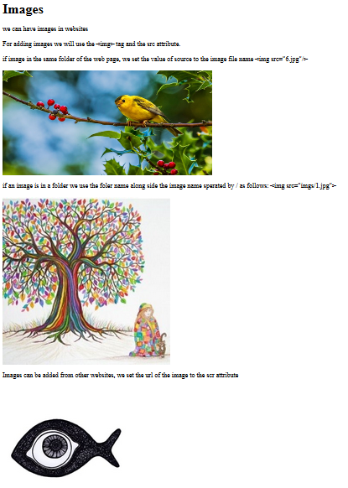

Slide 47
Resources
W3 School.

